Slide 1
3.1 Introduction to the criminal justice system
The set of processes and institutions used to investigate and determine the outcomes of criminal cases

Slide 2
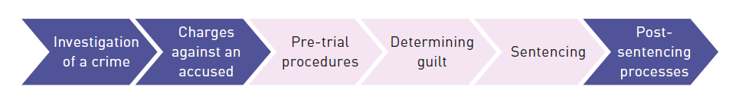
Key stages in a criminal case
Key purposes of the criminal justice system
To decide if the accused is guilty
To decide a sanction if the accused is found guilty (or pleaded guilty)
Notes:
We do not focus on the dark blue stages.

Slide 3
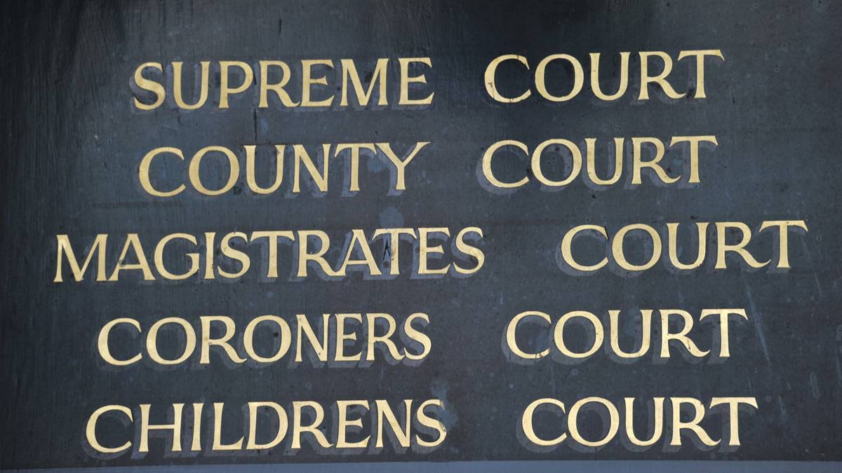
Notes:
We do not focus on the Coroners and Childrens Courts.

Slide 4

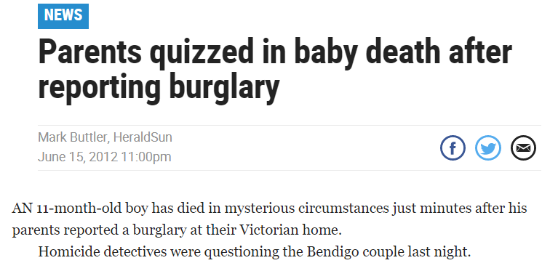

Slide 5
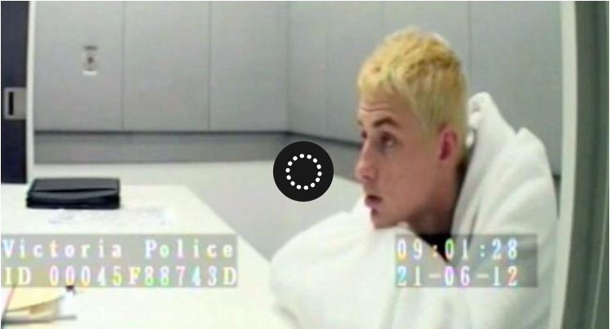

Slide 6
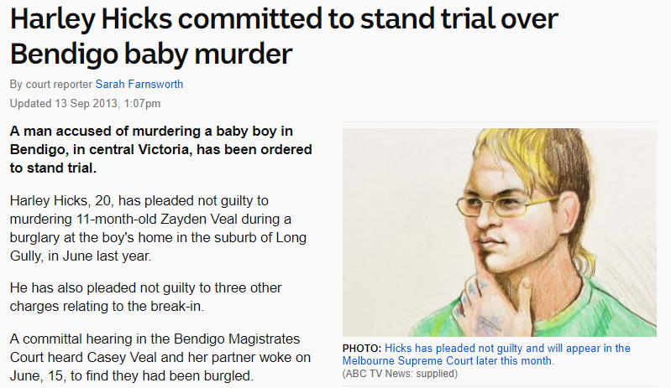

CiC

Slide 7


Slide 8


Slide 9



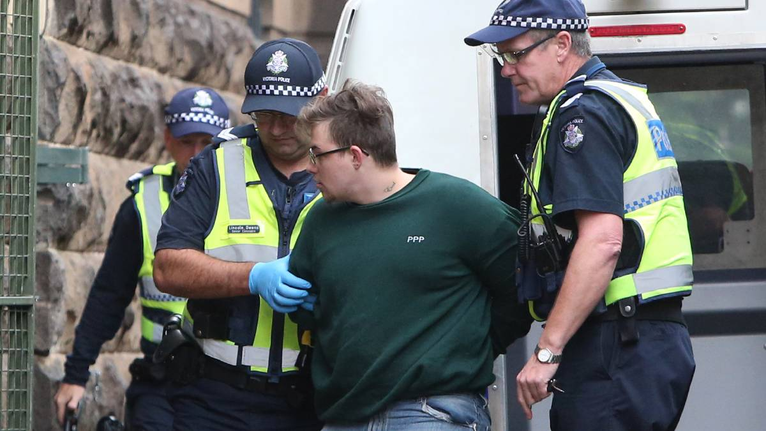

Slide 10

Parties to a case
The prosecution, acting on behalf of the state / the community
The accused (defendant)

Slide 11
TASKS
Read 3.1 Introduction to the criminal justice system
 | Notes (Yellow Book) | Tasks
3.1 Introduction to the criminal justice system | None | None

